Slide 1



ARTIFICIAL INTELLIGENCE AND MACHINE LEARNING
WEEK 5

Slide 2
Introduction to Machine Learning and Linear Regression

Slide 3
Agenda
Machine Learning:
Intro to Machine Learning – supervised and unsupervised.
Tools & Techniques
Overfitting and Under fitting
Linear Regression:
Relationship between Variables
Measures of Association
Measures of Regression Fit
Multiple Regression

Slide 4
Agenda (Contd.)
Logistic Regression:
Introduction to Logistic Regression.
Odds ratio and Logit function.
Math behind Logistic Regression.
Pros and Cons of Logistic Regression.
Model Evaluation:
Metrics for model evaluation
Confusion Matrix & F1 Score
Gini Coefficient and ROC

Slide 5
Machine Learning

Slide 6
Machine Learning
The ability of a computer to do few tasks without being explicitly programmed for such tasks.
Machine Learning automates model building using data as input, finding patterns in the data and summarizing the pattern in mathematically precise way.
Data, however, contains noise, absence of which would make machine learning trivial.
The biggest challenge in way of machine learning is to analyze the data to identify true information content while distilling away the noise.
To achieve the goal, machine learning uses the approach of having separate train and test data.

Slide 7
Supervised Learning
Building a mathematical model using data that contains both the inputs and the desired outputs (ground truth).
Examples:
Determining if an image has a horse. The data would include images with and without the horse (the input), and for each image we would have a label (the output) indicating if there is a horse in that image.
Determining is a client might default on a loan.
Determining if an employee is likely to quit.
Since we have desired outputs, model performance can be evaluated by comparisons.

Slide 8
Unsupervised Learning
Building a mathematical model using data that contains only inputs and no desired outputs.
It is used to find structure in the data, like grouping or clustering of data points. To discover patterns and group the inputs into categories.
Example:
An advertising platform segments the population into smaller groups with similar demographics and purchasing habits. Helping advertisers reach their target market with relevant ads.
Since no labels are provided, there is no specific way to compare model performance in most unsupervised learning methods.

Slide 9
Tools & Techniques
Supervised Learning
Regression: desired output is a continuous number
Classification: desired output is a category
Unsupervised Learning
Clustering: Grouping data
Dimensionality reduction: Compressing data
Association rule learning: If X then Y

Slide 10
Overfitting vs. Underfitting
If the model we finish with ends up
modeling the noise as well, we call it “over fitting” - bad for prediction!
not modeling all the information, we call it “under fitting” -bad for prediction!
The hope is that the model that does the best on testing data manages to capture/model all the information but leave out all the noise.

Slide 11
Linear Regression

Slide 12
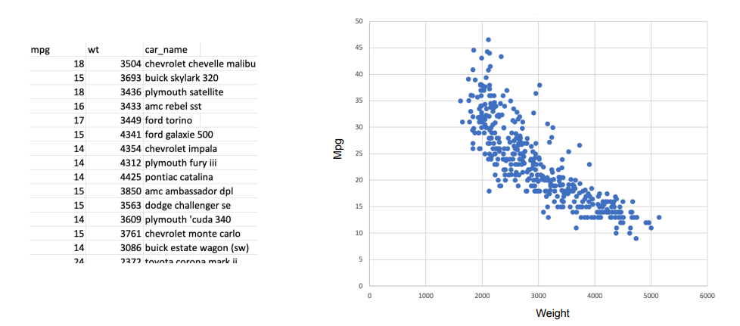
Linear Regression
Liner Regressing is used to understand or determine if a relationship exists between two variables such as:
Do heavier cars result in lower milage?
This example above aims to use data to better understand the relationship between 2 variables (weight of the car, and miles per gallon produced by the car).

Slide 13
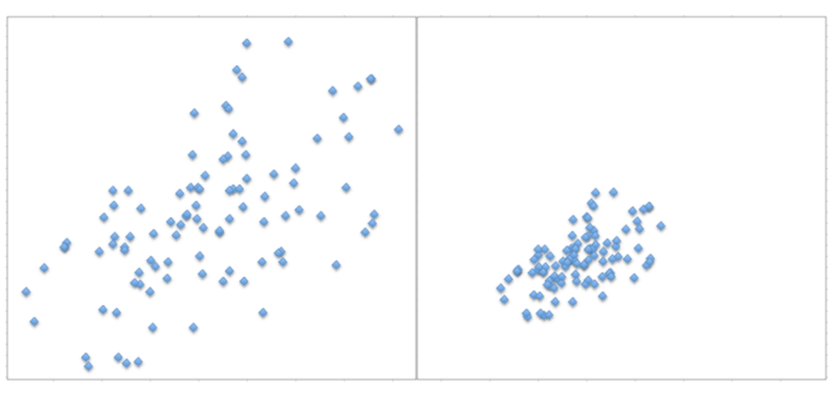
Quick Quiz
Which graph of the two demonstrates stronger relationship?

Slide 14
Measures of Association
To determine the strength between two variables, we need a measure of association between them.
By association we mean the strength (and direction) of a linear relationship between two numerical variables.
The relationship is “strong” if the points in a scatterplot cluster tightly around some straight line. If this line rises form left to right, then the relationship is “positive”. If it falls from left to right, then the relationship is “negative”.
We know that variance of a variable X is:
On a similar note lets deﬁne “covariance” between X and Y as:

Slide 15
Measures of Association (contd.)
Covariance:
Covariance between X and Y is the same as the covariance between Y and X.
The covariance between a variable and itself is the variance of the variable.
It is difﬁcult to interpret the magnitudes of covariances since it is not scaling invariant.
Correlation:
We can scale covariance to make it an invariant measure of linear association!
Correlation between X and Y is
Correlation is always between -1 and +1.The correlation between a variable and itself is 1.
The correlation between X and Y is the same as the correlation between Y and X.
Correlation is scale invariant

Slide 16
Measures of Association (contd.)
Interpreting Correlations: If correlation between weight and MPG is -0.83,
Does heavier car tend to have a lower mileage?
If we increase the weight of a car, will the MPG decrease?
Correlation and covariance are measures of linear association only.
Correlation can be misleading when the association is non- linear.
Outliers can have signiﬁcant effects on correlations.
Outliers that are clearly identiﬁable are best deleted before correlation computations.

Slide 17
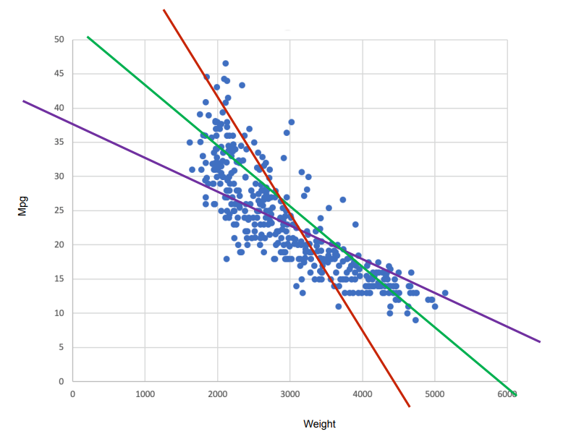
Quick Quiz
How easy is it to fit a straight line?

Slide 18
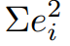
Best Fit Line
Possibilities that make sense
Choosing a line that (in some sense) minimizes the vertical distances from the point to the line.
We also choose to minimize the sum of the “squares” of this vertical distances!!! For mathematical convenience.
This method is called the “Least Squares Estimation” usually also referred to as “Linear Regression”
Note that, Observed Value = Fitted Value + Residual
Fitted Value: The predicted value of the response variable. It is the y-axis value of the line.
Residual: The difference between the actual and ﬁtted values of the response variable.
Observed Value: The actual value of the response variable
Least Squares line is the one that minimizes the sum of the squared residuals.
If we denote the i^{th} residual by e_{i}, then we are minimizing:
All statistical software automate this method.

Slide 19
Quick Quiz
If the car’s weight is 4000, what would we expect its MPG to be?

Slide 20
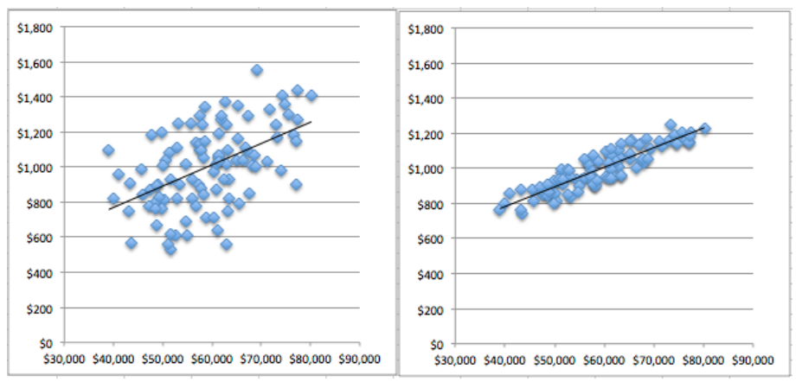
Quick Quiz
How good is our regression fit?

Slide 21
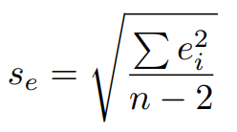
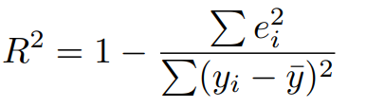
Measures of Regression Fit
Standard deviation of the residuals. Sometimes also called the Root Mean Sq Error (RMSE)
Comparing RMSE to Standard Deviation of y
Coefficient of determination
Lends itself to a really nice interpretation:
It is the percentage of variation of the dependent variable explained by the regression.
In simple linear regression, it is simply the square of the correlation!
R² = SSR/SST has no units and lies between 0 and 1

Slide 22
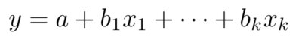
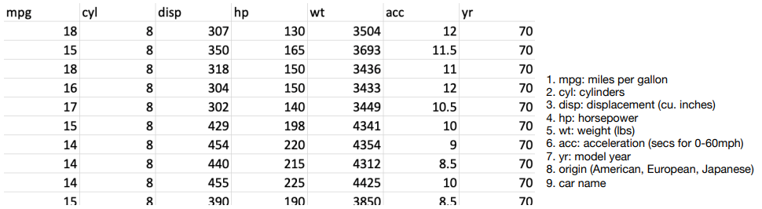
Multiple Regression
One dependent variable. More than one independent variable.
The regression model (equation)
The above is the equation of a hyper-plane set in k dimensions
Again, use the similar arguments to ﬁnd the best hyper-plane by minimizing the least squares measure.
Very easily computed using most Statics of ML tools

Slide 23
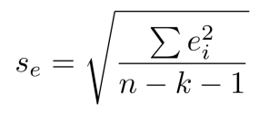
Standard Error and Adjusted R²
Standard Error for Multiple Regression
Adjusted R²
A measure that adjusts for the number of independent variables used
Used to monitor if more independent variables belong to the model
Cannot be interpreted as “percentage or variation explained”

Slide 24
Pros & Cons
Pros:
Simple elegant model,
Computationally very efﬁcient,
Easy to interpret the output’s coefﬁcient.
Cons:
Sometimes its just too simple to capture real-world complexities,
Assumes a linear relationships between dependent and independent variables,
Outliers can have a large effect on the output,
Assumes independence between attributes.

Slide 25
Logistic Regression

Slide 26
Introduction to Logistic Regression
In statistics, the logistic model is a statistical model that is usually taken to apply to a binary dependent variable.
In regression analysis, logistic regression or logit regression is estimating the parameters of a logistic model.
In Logistic Regression, the dependent variable is binary rather than continuous and it can also be applied to ordered categories (ordinal data).
The term “Odds”
Popular in horse races, sports, gambling, epidemiology etc.
Instead of talking about the probability of winning or contacting a disease, people talk about the odds of winning or contacting a disease

Slide 27
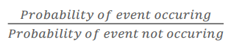
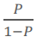
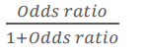
Quick Quiz
What is probability of A– P(A)?
Odds Ratio =
Odds Ratio =
Probability =
How is ‘Odds’ different from ‘Probability’?

Slide 28
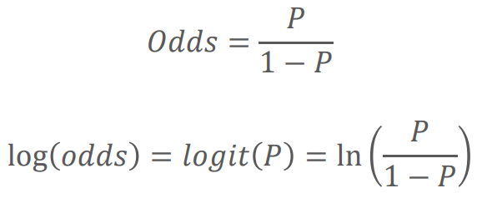
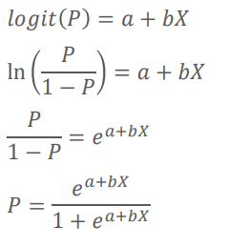
Math behind Logistic Regression
Logit
In logistic regression, the dependent variable is a logit, which is the natural log of the odds, that is,
So, a logit is a log of odds and odds are a function of P, where P is the probability. It is a type of function that creates a map of probability values from (0 , 1) to (-∞ , +∞)
In logistic regression, we find

Slide 29
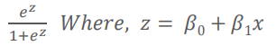
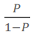
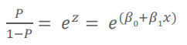
Math behind Logistic Regression (contd.)
Predict likelihood or probability
Predicted value - >0 and <1
Use of sigmoid function to achieve this
Probability P =
Odds Ratio =
Substituting for P, Odds Ratio =

Slide 30
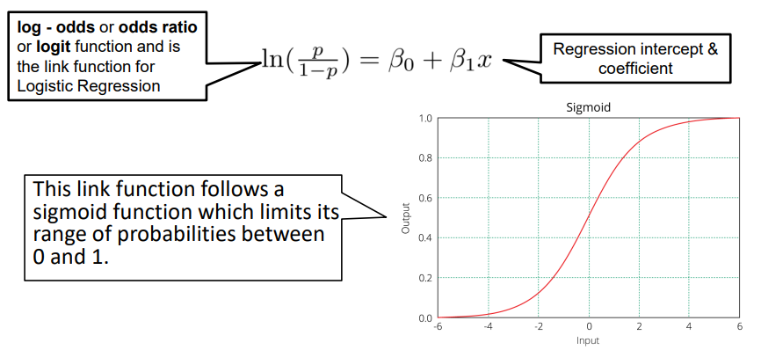
Equation of Logistic Regression

Slide 31
Pros & Cons
Pros:
It is a model that gives probabilities.
It can be easily scaled to multiple classes.
It is very quick to train and very fast at classifying unknown records.
Cons:
The classifies constructs liner boundaries.
Assumes that the variables are independent.
Interpretation of coefficients is difficult.

Slide 32
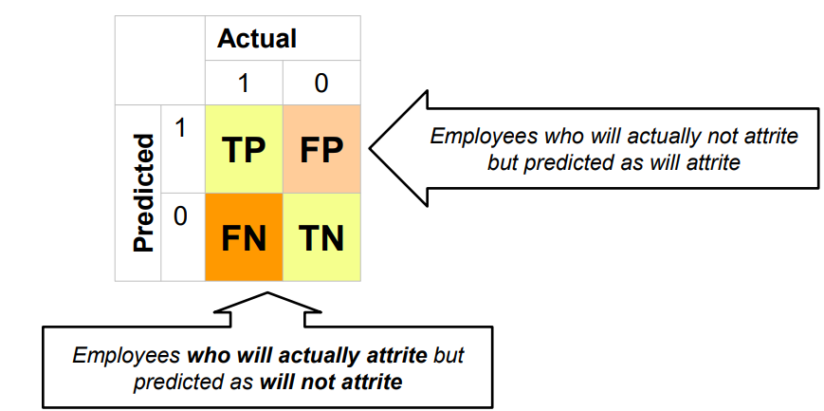
Confusion Matrix
It is a performance measurement for machine learning classification problem where output can be two or more classes. It is a table with 4 different combinations of predicted and actual values.

Slide 33
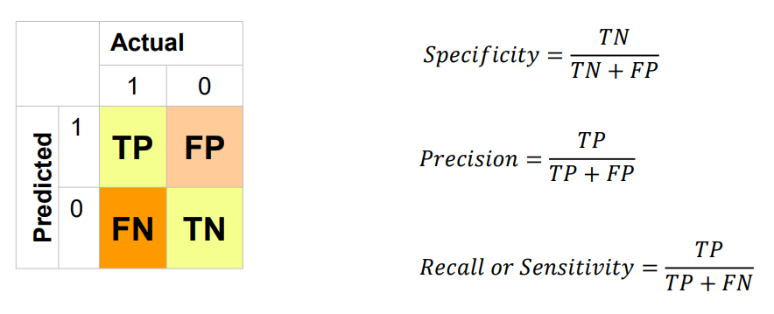
Confusion Matrix (contd.)

Slide 34
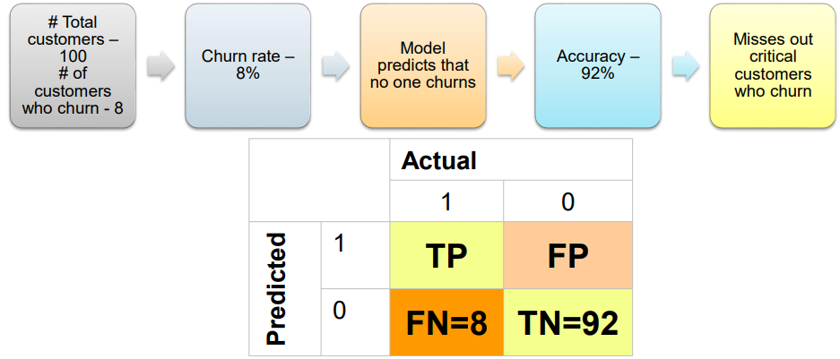
Why Accuracy is not a Good Model Performance Indicator?

Slide 35
F1 Score
A single metric is not sufficient for the evaluation of classification models. We have seen that we need to use recall and precision together along with accuracy to evaluate our model. Let us consider another metric that puts together the recall and precision metrics. We call it F1 Score which is the harmonic mean of the two metrics – Precision and Recall.
F1 Score = 2(precision*recall)/precision + recall
The F1 score can also be used to evaluate the model.

Slide 36
ROC AUC
ROC is a curve which allows us to compare models.
It is plot between TPR (True Positive Rates) and FPR (False Positive Ratio).
The area under the ROC curve (AUC) is a measure of the how good a model is.
The value for AUC lies between 0 and 1. Larger AUC implies better model.

Slide 37
Gini Coefficient
It is also used to measure the goodness of a fit.
It is the ratio of areas in a ROC curve and is scaled version of the AUC.
GI = 2*AUC -1
The larger the Gini coefficient the better the model is.

Slide 38
Logistic Regression - Exercise
Problem Overview:
The dataset used here is Credit risk data.
Credit risk is nothing but the default in payment of any loan by the borrower. In Banking sector this is an important factor to be considered before approving the loan of an applicant. Dream Housing Finance company deals in all home loans. They have presence across all urban, semi urban and rural areas. Customer first apply for home loan after that company validates the customer eligibility for loan.
Company wants to automate the loan eligibility process (real time) based on customer detail provided while filling online application form. These details are Gender, Marital Status, Education, Number of Dependents, Income, Loan Amount, Credit History and others. To automate this process, they have given a problem to identify the customers segments, those are eligible for loan amount so that they can specifically target these customers. Here they have provided a partial data set.

Slide 39
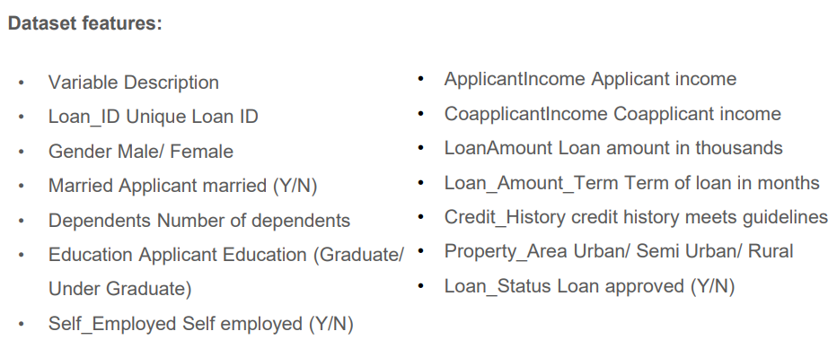
Exercise Contd.

Slide 40
Exercise Contd.
Steps to follow:
Importing Libraries.
Check for the features, use the tools at your dispense to gather insights of the features.
Identify the opportunities to do the required preprocessing of your data.
Get rid of the inconsistency, remove missing values.
Take 70:30 training and test set.
Fit the model on train data.
Check for the fit on the test data.
Choose the best metric and give business insights.

Slide 41

QUESTION & ANSWER

